Slide 1
Minimum viable programmer
Rebecca Scott | me@rebeccascott.name | becdetat.com
Senior Consultant at SixPivot | sixpivot.com.au
Notes:
Hi. I’m Rebecca.
I’m currently a consultant at SixPivot, and I’ve worked either as a consultant or in small businesses and startups throughout most of my career.
Apart from my consulting work,
I also manage a few internal projects
Like mentoring and professional development,
PD and mental health are two things I’m passionate about.

Slide 2
Minimum Viable Programmer
"Eight hours' labour, Eight hours' recreation, Eight hours' rest”
- Robert Owen, 1817
Rebecca Scott | me@rebeccascott.name | becdetat.com
Notes:
The kind of work we do encourages long hours,
and learning in our own time.
I don't think this is sustainable in the long term.
Burn-out and mental health issues are common,
Our personal lives suffer, and so does the work we’re able to do.
So when I'm working now, I need to be careful about what I decide to do at any moment.
I’m going to talk about some ideas and principles I've learned so far in my career,
and how I use them to help me make good decisions.

Slide 3
Minimum Viable Programmer
Rebecca Scott | me@rebeccascott.name | becdetat.com
Notes:
My first real job in IT was building in-house systems for a small financial planning firm in Regional Queensland.
I was the only developer, my job title was IT manager,
and I was there for about eight years.
That job let me work directly with stakeholders, end users, and clients.
and I needed to learn how to quickly make good or “good enough” decisions.

Slide 4
Minimum Viable Programmer
Rebecca Scott | me@rebeccascott.name | becdetat.com
Notes:
I also worked very long hours,
I’d pull overnighters,
Work weekends.
I regularly took work home with me,
And I spent most of my “free” time learning and trying to “level up”.
Learning in your own time as a developer can be important,
But we should do this responsibly.
Even though I was learning to make good decisions for my job,
I wasn’t applying what I had learned to my own life.
DRINK

Slide 5
Minimum Viable Programmer
“great, another armchair psychologist.”
- probably you right now
Rebecca Scott | me@rebeccascott.name | becdetat.com
Notes:
I think that understanding how we make decisions is essential to improving those decisions.
This can make us better developers,
And work more sustainably.

Slide 6
Minimum Viable Programmer
Last Responsible Moment
Cost vs benefit, logical fallacies
Hustle?
Rebecca Scott | me@rebeccascott.name | becdetat.com
Notes:
These are themes I want to cover.
I'm a strong believer in the Last Responsible Moment principle.

Slide 7
Minimum Viable Programmer
Last Responsible Moment
Cost vs benefit, logical fallacies
Hustle?
Rebecca Scott | me@rebeccascott.name | becdetat.com
Notes:
Investments, and cost-benefit analysis,
Logical fallacies - inherent biases that humans have evolved,
that can lead to bad decision making processes in modern life.

Slide 8
Minimum Viable Programmer
Last Responsible Moment
Cost vs benefit, logical fallacies
Hustle?
Rebecca Scott | me@rebeccascott.name | becdetat.com
Notes:
I’ll also talk about reducing your cognitive load,
hustle versus sustainability,
and how to make better decisions
DRINK

Slide 9
Minimum Viable Programmer
Last Responsible Moment
Rebecca Scott | me@rebeccascott.name | becdetat.com
Notes:
I want to mention the Last Responsible Moment principle.
I use it a lot, for both big and small decisions

Slide 10
Minimum Viable Programmer
Concurrent development makes it possible to delay commitment until the last responsible moment, that is, the moment at which failing to make a decision eliminates an important alternative.
- Lean Software Development: An Agile Toolkit, by Mary and Tom Poppendieck (emphasis mine)
Rebecca Scott | me@rebeccascott.name | becdetat.com
Notes:
Basically, the last responsible moment principle
Is that we should avoid making a decision
until the point where the cost of not making the decision
is greater than the cost of making it.

Slide 11
Minimum Viable Programmer
Concurrent development makes it possible to delay commitment until the last responsible moment, that is, the moment at which failing to make a decision eliminates an important alternative.
- Lean Software Development: An Agile Toolkit, by Mary and Tom Poppendieck (emphasis mine)
Rebecca Scott | me@rebeccascott.name | becdetat.com
Notes:
For me, this means getting just enough information
to make important decisions at the point where they have to be made.
When I’ve got less information,
I also like to make important decisions early,
but in a way that lets me change those decisions later
and shift direction without big costs.
DRINK

Slide 12
Sunk cost fallacy
Ambiguity effect
Cost-Benefit analysis
Asking good questions
Applying the LRM principle
Breaking the rules
Deferring learning
Hustle vs Sustainability
Rebecca Scott | me@rebeccascott.name | becdetat.com
Notes:
Here’s what I’m going to cover:
Two logical fallacies:
the sunk cost fallacy, and the ambiguity effect.
Cost-benefit analysis, and why it’s important,
How to ask good questions, to make sure we’re working with good data,
Applying the Last Responsible Moment Principle when making decisions,
Knowing the rules and when to break them,
And deferring learning, so we’re focusing on the right things at the right time.
Then I’ll talk about hustle, our tendency to do too much,
And why we need to think about sustainability.
DRINK

Slide 13
Sunk cost fallacy
Ambiguity effect
Cost-Benefit analysis
Asking good questions
Applying the LRM principle
Breaking the rules
Deferring learning
Hustle vs Sustainability
Rebecca Scott | me@rebeccascott.name | becdetat.com
Notes:
When we make decisions, we’re affected by cognitive biases and logical fallacies.
A bias is a preference for one direction or choice over another.
Cognitive biases and logical fallacies are biases that affect our cognitive processes – how we make decisions.
These are things that humans have evolved to make our decision-making process more efficient,
But often those biases cause us to make the wrong decision.

Slide 14
Sunk cost fallacy
Sunk cost: something that has been spent and can’t be recovered
Rebecca Scott | me@rebeccascott.name | becdetat.com
Notes:
A sunk cost is a cost that’s already been spent and can't be recovered.

Slide 15
Sunk cost fallacy
“I paid $10000 for these stocks, I can't sell them for $5000!”
(even though you could spend that $5000 on an investment that has a better future return than your existing investment)
Rebecca Scott | me@rebeccascott.name | becdetat.com
Notes:
The sunk cost fallacy is the tendency for sunk costs
– past decisions
- to influence future decisions,
by believing that the investment
- the sunk cost
justifies future costs against that investment,
And discounting other possibilities that might give better value and outcomes.
Essentially, throwing good money after bad
DRINK

Slide 16
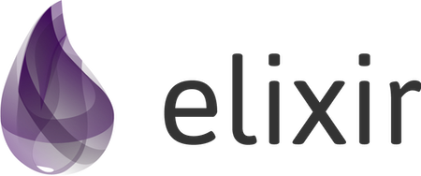
Sunk cost fallacy
“A past team member wrote a key component in our system using Elixir.
It’s buggy, the team member has moved on, and nobody knows enough Elixir to maintain it.
This component is starting to become a liability.”
Rebecca Scott | me@rebeccascott.name | becdetat.com
Notes:
Once, I inherited a system with a component that a former team member had written in Elixir.
For context, we were a .NET shop
and the rest of the product was written in C#
The component mostly worked
but it didn’t handle some edge cases that caused some pretty nasty bugs

Slide 17
Sunk cost fallacy
"We're invested in using Elixir now, Employee X spent 5 weeks writing this component.
We can't just throw that work away.”
- someone deep in the sunk cost fallacy
Rebecca Scott | me@rebeccascott.name | becdetat.com
Notes:
Not changing direction in this case is actively making a decision to continue investing in the Elixir component.
You could identify two options at this point.

Slide 18
Sunk cost fallacy
Keep the component, learn Elixir, and take 4x time to fix the bugs and continue to maintain the component,
Or,
Throw away the component and start again in C# (which the entire team is familiar with)
Rebecca Scott | me@rebeccascott.name | becdetat.com
Notes:
Keep the Elixir component, and invest more time into fixing the bugs
Or, throw it away, and rewrite it in something the team is comfortable with.

Slide 19
Sunk cost fallacy
Keep the component, learn Elixir, and take 4x time to fix the bugs and maintain the component,
Or,
Throw away the component and start again in C# (which the entire team is familiar with)
Rebecca Scott | me@rebeccascott.name | becdetat.com
Notes:
Ignoring the sunk cost and going with option 2 is probably better in the long run.
The component is easier and cheaper to maintain
And the remaining team will be happier if they need to work on it.
Understanding that we are biased towards over-valuing investments made in the past,
Can help with making better future decisions
DRINK

Slide 20
Sunk cost fallacy
Rebecca Scott | me@rebeccascott.name | becdetat.com
Notes:
This can apply to small decisions, too.
A professional poker player will set what’s called a loss limit
an amount of money that they’re prepared to lose in a hand.
That way if they’re in a losing game they have a clear point where they can re-evaluate their position,
And decide whether or not to "cut their losses".

Slide 21
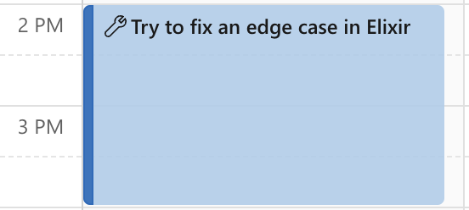
Sunk cost fallacy
Rebecca Scott | me@rebeccascott.name | becdetat.com
Notes:
This is like setting a time box.
You're working on a feature,
you have unknowns around the implementation,
and you want to experiment with it.
So, you set a time box of, say, two hours,
then at the end of the two hours you stop work and assess where you’re at.

Slide 22
Sunk cost fallacy
Rebecca Scott | me@rebeccascott.name | becdetat.com
Notes:
If it feels like you're on the right path
then you can consolidate what you've done,
And keep going.
But if it isn’t working out, then this is the time to cut your losses and find another solution.
Either way, you’re making a more informed decision without a big up-front cost.
DRINK

Slide 23
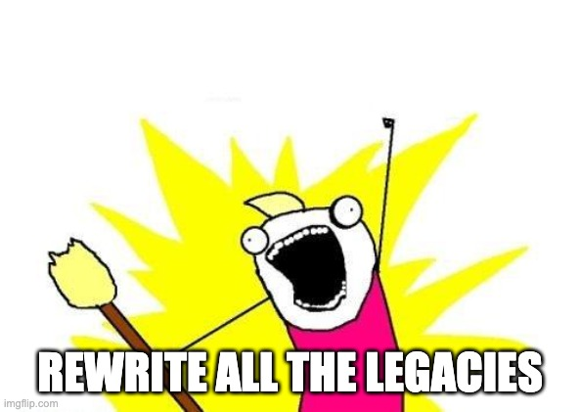
Sunk cost fallacy
Rebecca Scott | me@rebeccascott.name | becdetat.com
Notes:
Remember that just writing something off as a sunk cost might not be the best decision.
It’s easy to fall into the “rewrite all the things” trap.

Slide 24
Sunk cost fallacy
Port the Elixir code to C#
Rebecca Scott | me@rebeccascott.name | becdetat.com
Notes:
Option 3 might be that some of the Elixir component can be recovered and reused.
And, that’s what we did.
I took the Elixir code and ported it to C#, learning just enough Elixir as I needed to,
And I wrote unit tests and handled the edge cases.
As it turned out this only took about a day to do.
Being agile means both adapting to new conditions
and taking advantage of the existing environment.

Slide 25
Sunk cost fallacy
The sunk cost fallacy is the tendency for decisions that we’ve made and costs that we’ve incurred in the past to influence our future decisions, at the risk of making poor decisions.
Rebecca Scott | me@rebeccascott.name | becdetat.com
Notes:
So, the sunk cost fallacy is the tendency for our past investments,
our past decisions,
to be over-valued and adversely affect our future decisions.
DRINK

Slide 26
Sunk cost fallacy
Ambiguity effect
Cost-Benefit analysis
Asking good questions
Applying the LRM principle
Breaking the rules
Deferring learning
Hustle vs Sustainability
Rebecca Scott | me@rebeccascott.name | becdetat.com
Notes:
The ambiguity effect is where we tend to avoid options
where we don't know the probability of a favourable outcome,
and instead prefer options where there's less ambiguity,
but have worse outcomes.
The ambiguity effect is a type of risk adverse decision making.
Instead of deciding on a more favourable outcome,
we choose a worse outcome that feels safer.
We’re adverse to favourable options that have unknowns.

Slide 27
Ambiguity effect
Analysis paralysis
Rebecca Scott | me@rebeccascott.name | becdetat.com
Notes:
Sometimes the result of the Ambiguity effect is deferring making a decision,
Waiting until you have more and more information.
This can become analysis paralysis,
where the unknowns prevent you from making a decision and being able to move forward.
DRINK

Slide 28
Ambiguity effect
React
vs
Svelte
Rebecca Scott | me@rebeccascott.name | becdetat.com
Notes:
Say you need to decide which framework to use for a new project.
You've narrowed down your choices to React and Svelte.

Slide 29
Ambiguity effect
export default function Counter() {
const [count, setCount] = useState(0);
const increment = () => {
setCount(count + 1);
};
return (
<div>
<p>Count: {count}</p>
<button onClick={increment}>Increment</button>
</div>
);
}
Rebecca Scott | me@rebeccascott.name | becdetat.com
Notes:
Now, React’s a well-known, widely used framework,
But, for beginners, it can be difficult to learn.

Slide 30
Ambiguity effect
<script>
let count = 0;
function increment() {
count += 1;
}
</script>
<div>
<p>Count: {count}</p>
<button on:click={increment}>Increment</button>
</div>
Rebecca Scott | me@rebeccascott.name | becdetat.com
Notes:
Svelte is a much newer framework,
That’s been designed in a way that can be easier to learn than React.
However, since it's so new,
there can be a learning curve for developers that are experienced with React,
and it can be more difficult to find documentation and examples.
There’s more unknowns.

Slide 31
Ambiguity effect
// It is me, your React expert:
export default function Counter() {
const [count, setCount] = useState(0);
const increment = () => {
setCount(count + 1);
};
return (
<div>
<p>Count: {count}</p>
<button onClick={increment}>Increment</button>
</div>
);
}
<script>
// What about Svelte?
let count = 0;
function increment() {
count += 1;
}
</script>
<div>
<p>Count: {count}</p>
<button on:click={increment}>Increment</button>
</div>
Rebecca Scott | me@rebeccascott.name | becdetat.com
Notes:
There’s pros and cons for each option that I don’t need to go into.
But, if you're more familiar with React,
the ambiguity effect means that you’ll tend to discount
the pros of the unfamiliar option of using Svelte,
Even if the benefits outweigh the actual cost.

Slide 32
Ambiguity effect
// React
export default function Counter() {
const [count, setCount] = useState(0);
const increment = () => {
setCount(count + 1);
};
return (
<div>
<p>Count: {count}</p>
<button onClick={increment}>Increment</button>
</div>
);
}
<!-- Svelte -->
<script>
let count = 0;
function increment() {
count += 1;
}
</script>
<div>
<p>Count: {count}</p>
<button on:click={increment}>Increment</button>
</div>
Rebecca Scott | me@rebeccascott.name | becdetat.com
Notes:
Maybe a middle ground is to experiment,
Use Svelte for a week to see how far you can go.
Sometimes it’s better to commit to a decision that you can easily change when you've got more information.
The cost of the experiment can be a good investment.

Slide 33
Ambiguity effect
The ambiguity effect is the tendency to select an option that has less unknowns, even if an alternative option has better outcomes.
Rebecca Scott | me@rebeccascott.name | becdetat.com
Notes:
So, unknowns are a type of risk, and risks can be managed.
Avoiding the ambiguity effect means treating unknowns as manageable risks,
Rather than letting them unconsciously guide your decision-making process.
DRINK

Slide 34
Sunk cost fallacy
Ambiguity effect
Cost-Benefit analysis
Asking good questions
Applying the LRM principle
Breaking the rules
Deferring learning
Hustle vs Sustainability
Rebecca Scott | me@rebeccascott.name | becdetat.com
Notes:
Cost-benefit analysis is where you work out the cost of doing something,
the benefit that you'll get from doing it,
and do a comparison to make a more informed decision.

Slide 35
Sunk cost fallacy
Ambiguity effect
Cost-Benefit analysis
Asking good questions
Applying the LRM principle
Breaking the rules
Deferring learning
Hustle vs Sustainability
Rebecca Scott | me@rebeccascott.name | becdetat.com
Notes:
Often we make decisions based on "intuition” or “gut feel”.
This can be ok for some small decisions,
Or where you’ve solved similar problems before and can apply your experience,
but a lot of our decisions do matter and affect our day or week or project.
It can be a good idea to do a quick cost-benefit analysis to help with those decisions.
DRINK

Slide 36
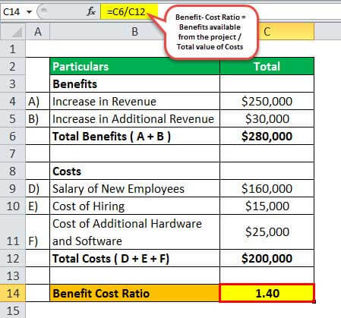
Cost-Benefit analysis
Rebecca Scott | me@rebeccascott.name | becdetat.com
Notes:
In finance, a cost-benefit analysis is quantitative
You give each cost or benefit a numeric value,
usually in dollars

Slide 37
Cost-Benefit analysis
Rebecca Scott | me@rebeccascott.name | becdetat.com
Notes:
But, with the types of decisions we’re talking about, some things can’t be assigned a number
Like, a cost that is “this is boring", or "this isn't fun".
For me these are still real costs.
So don’t worry about quantifying everything.
But I find that doing a cost-benefit analysis can help with making decisions.

Slide 38
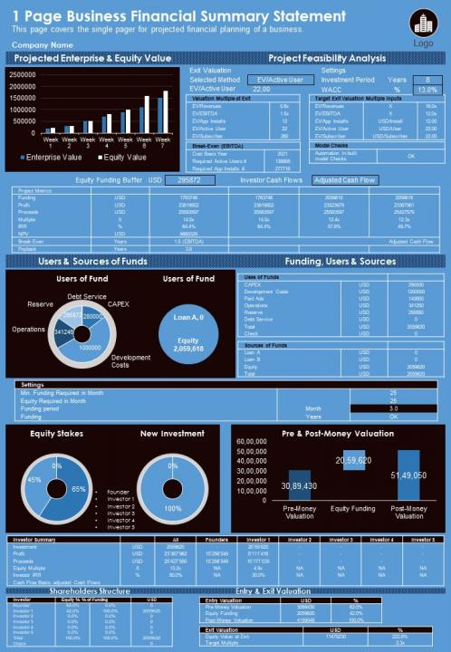
Cost-Benefit analysis
(not the client’s application)
Rebecca Scott | me@rebeccascott.name | becdetat.com
Notes:
A while ago I needed to make a recommendation to my client about how we could build a new feature
And give an estimate of how long implementing it would take.
We wanted to add filtering to a complex dashboard,
And at this point I wasn’t familiar with the application.

Slide 39
Cost-Benefit analysis
(not the client’s application)
Rebecca Scott | me@rebeccascott.name | becdetat.com
Notes:
My first thought was that I should dive into the UI and work my way up to the raw data.
Mapping out the data flows so I could understand it end to end.
This felt like the right decision, because then I could figure out precisely how to build the feature.
But I realised this would take a long time,
And it’d be really boring and tedious.
So I needed to decide how to proceed – how I would spend the rest of the day.
I did a mental cost-benefit analysis.

Slide 40
Cost-Benefit analysis
Full, deep analysis
Cost | Benefit
Lots of work | Full understanding of the application
Not very fun | Can give a detailed explanation of the implementation
Will take a long time | Very low risk for the eventual implementation
Limited, high-level analysis
Cost | Benefit
Higher risk when implementing | Fast
Doesn't teach me details about the application | Don't have to dive into lots of code
Can't give a detailed explanation | I don't have to understand the entire system
Leaves some questions unanswered | Provides the answers that are needed right now
Increased chance that I might be wrong
Rebecca Scott | me@rebeccascott.name | becdetat.com
Notes:
A full, deep exploration,
Versus a more limited, higher level overview.
Both options had legitimate costs and benefits.
And it still wasn’t clear what was the best choice.

Slide 41
Cost-Benefit analysis
“Do I need to completely understand the application right now?”
Rebecca Scott | me@rebeccascott.name | becdetat.com
Notes:
I realized that to choose, I needed to understand
What’s important to me at this moment?
If I don't do that full analysis,
I might make a mistake,
or I might miss something.
Was that ok? Was it an acceptable risk?

Slide 42
Cost-Benefit analysis
Full, deep analysis
Cost | Benefit
Lots of work | Full understanding of the application
Not very fun | Can give a detailed explanation of the implementation
Will take a long time | Very low risk for the eventual implementation
Limited, high-level analysis
Cost | Benefit
Higher risk when implementing | Fast
Doesn't teach me details about the application | Don't have to dive into lots of code
Can't give a detailed explanation | I don't have to understand the entire system
Leaves some questions unanswered | Provides the answers that are needed right now
Increased chance that I might be wrong
Rebecca Scott | me@rebeccascott.name | becdetat.com
Notes:
In this case, I decided it was.
My client just wanted to know if the feature was possible,
Understand roughly how it could be implemented,
and get an informed estimate from the team.
Deciding to do the limited, high-level analysis
meant I could provide a recommendation in a few hours,
rather than say 3 days for a full analysis.

Slide 43
Cost-Benefit analysis
What data is coming in – inputs
What we want to see – outputs
What additional data we need to do the filtering
Where the filtering needs to happen
Rebecca Scott | me@rebeccascott.name | becdetat.com
Notes:
My job wasn’t to understand the application in detail.
I knew what the outcome should be.
I just needed to know what data was coming in,
what data we needed for the filtering,
and roughly where in the code the filtering needed to happen.

Slide 44
Cost-Benefit analysis
What data is coming in – inputs
What we want to see – outputs
What additional data we need to do that
Where the filtering needs to happen
Rebecca Scott | me@rebeccascott.name | becdetat.com
Notes:
That was all I needed to do my job.
Anything outside of that was irrelevant.
In the end my client was happy,
and got back a few days budget that could be used to actually implement the feature.

Slide 45
Cost-Benefit analysis
Cost-benefit analysis is an approach to evaluating the pros and cons of a decision, by making a comparison of the costs and benefits of that decision.
It gives us a systematic framework to compare alternative decisions.
Rebecca Scott | me@rebeccascott.name | becdetat.com
Notes:
So, using a simple cost-benefit analysis helps us
make better, more rational,
more informed decisions
DRINK

Slide 46
Sunk cost fallacy
Ambiguity effect
Cost-Benefit analysis
Asking good questions
Applying the LRM principle
Breaking the rules
Deferring learning
Hustle vs Sustainability
Rebecca Scott | me@rebeccascott.name | becdetat.com
Notes:
To make good decisions, we need good information.
To get that information, we need to be able to ask good questions.

Slide 47
Asking good questions
Step Zero
“Bring me your finest subject matter experts!”
Rebecca Scott | me@rebeccascott.name | becdetat.com
Notes:
Step zero is understanding who to ask what.
Spend some time up-front figuring out who these people are.
Whenever I join a project,
one of the first things I do is note down the people that I should be talking to about what.
If you can get access to end users, talk to them too when it’s appropriate.

Slide 48
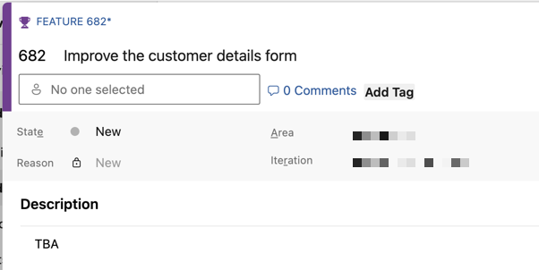
Asking good questions
Rebecca Scott | me@rebeccascott.name | becdetat.com
Notes:
Even when you're working with the best BAs, UX designers, and product owners,
It’s common to get work where you don’t have all the information you need.
You’re going to need to make decisions,
And to do that responsibly, you need to ask questions.
Make sure you're asking the right questions and getting meaningful answers.

Slide 49
Asking good questions
Context!
Rebecca Scott | me@rebeccascott.name | becdetat.com
Notes:
Understand the context
A hospital is probably going to have very different needs to a supermarket.
A data entry form for a supermarket
Probably needs to be optimised for speed.
But a data entry form for a hospital
may need to slow down users with checks to limit errors.

Slide 50
Asking good questions
“Does this date field need the time?”
vs
“Can you explain to me what this field is going to be used for?”
Rebecca Scott | me@rebeccascott.name | becdetat.com
Notes:
Understanding context helps you decide which questions to ask.
Guide the conversation, but try not to ask leading questions.
Use open ended questions and let people explain rather than tell.

Slide 51
Asking good questions
“Does this date field need the time?”
vs
“Can you explain to me what this field is going to be used for?”
Rebecca Scott | me@rebeccascott.name | becdetat.com
Notes:
Asking "Does this date field need the time?"
is very specific and is probably going to get a very concise answer.
"Can you explain what this field is going to be used for?”
Is much more open-ended and the answer might be more relevant and deeper.
Asking the first question might miss some detail that could be important,
You might make poorer decisions and need to rework or revisit them.

Slide 52
Asking good questions
“That field is to record the time we did the maintenance work.”
Clarify: “Is that the time you started the work, or when you finished it?”
Rebecca Scott | me@rebeccascott.name | becdetat.com
Notes:
Make sure you're clarifying and asking follow-up questions,
when you're not sure,
and when you think that your client or subject matter expert isn’t sure.
DRINK

Slide 53
Asking good questions
Information bias: The tendency to collect more information that is needed to understand a problem, or make a decision
Rebecca Scott | me@rebeccascott.name | becdetat.com
Notes:
Be careful of the information bias.
This is the tendency to try to get more information than we actually need to make a decision.
Keep in mind the problem you’re actually solving.

Slide 54
Asking good questions
Take time to reflect on your understanding
Don't make assumptions
Iterate
Rebecca Scott | me@rebeccascott.name | becdetat.com
Notes:
And, reflect on what you've learned,
what you've got gaps on,
any assumptions you've made.
Iterate if you need to.
Most people prefer being asked more questions
than finding out later that you’ve made poor decisions,
based on a gap in understanding.

Slide 55
Asking good questions
Find the right people.
Get the right context.
Avoid leading questions.
Ask open-ended questions.
Ask for clarification.
Avoid the information bias – prefer valuable questions.
Avoid making assumptions.
Reflect and iterate.
Rebecca Scott | me@rebeccascott.name | becdetat.com
Notes:
Asking good questions is a skill that’s learned over time
But it’s essential to understanding problems and making good, informed decisions.
DRINK

Slide 56
Sunk cost fallacy
Ambiguity effect
Cost-Benefit analysis
Asking good questions
Applying the LRM principle
Breaking the rules
Deferring learning
Hustle vs Sustainability
Rebecca Scott | me@rebeccascott.name | becdetat.com
Notes:
The Last Responsible Moment principle is one of my favourite tools.
I use it every day, for both big and small decisions.

Slide 57
Applying the Last Responsible Moment principle
Ambiguity effect: tending towards a choice we’re more familiar with, even given a choice with a better outcome
Rebecca Scott | me@rebeccascott.name | becdetat.com
Notes:
Sometimes we're operating on limited data.
So remember that we’ve got those cognitive biases.
But even then, you won’t always make the best decision the first time around.
So, try to design your day in a way that doesn't stop you from changing course.
Rather than going down a path just because it seems familiar,
invest some time in seeing if there’s a better path first.

Slide 58
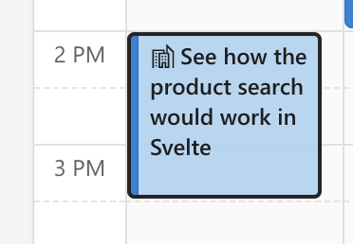
Applying the Last Responsible Moment principle
Rebecca Scott | me@rebeccascott.name | becdetat.com
Notes:
Time-boxing an investigation or doing a technical spike
can be a great way to explore a decision without fully committing to it,
and lets you pivot to something else later if you find out that it's the wrong decision.
Doing an experiment can be a good investment in your time
if it lets you make a more informed decision
about something critical to your larger goals.
DRINK

Slide 59
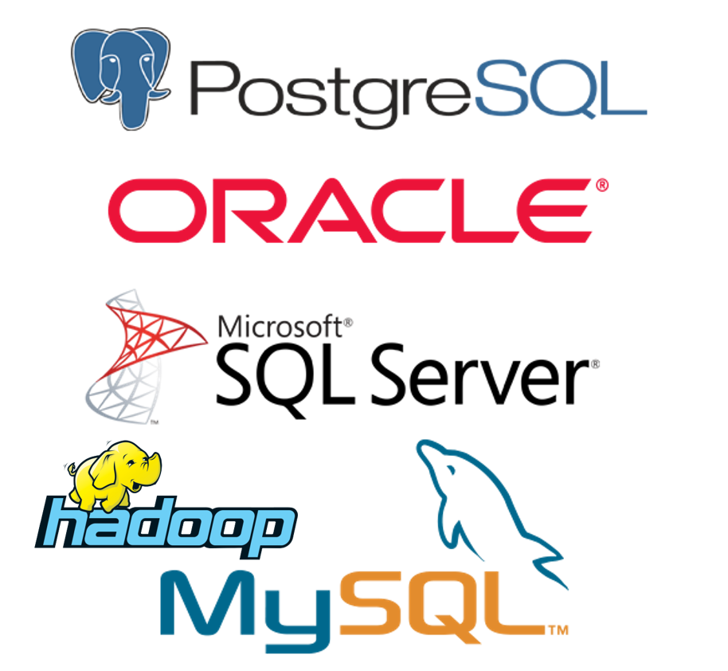
Applying the Last Responsible Moment principle
Every good tech slide deck needs a page full of database vendor logos
Rebecca Scott | me@rebeccascott.name | becdetat.com
Notes:
Say you're building a system and need to decide which database vendor to use.
It’d seem totally reasonable to say that this decision should be made early,
because you’re probably going to need a database to start building the system.
DRINK

Slide 60
Applying the Last Responsible Moment principle
Rebecca Scott | me@rebeccascott.name | becdetat.com
Notes:
But, software development isn’t civil engineering
Not all decisions need to be fixed early
What if, instead of committing to a specific vendor early in the project,
you made an early but flexible decision.

Slide 61
Applying the Last Responsible Moment principle
Rebecca Scott | me@rebeccascott.name | becdetat.com
Notes:
So, you can start development on the system as soon as possible.
But, you work in a way that has a low switching cost if you later decide to change the database vendor.
Like, avoiding vendor-specific features,
or using an abstraction like an ORM.

Slide 62
Applying the Last Responsible Moment principle
Rebecca Scott | me@rebeccascott.name | becdetat.com
Notes:
Or by making good software design decisions
like separating the data layer from the business rules and UI.
Then, if later you need to change database vendors,
You don’t have that huge switching cost.
You’ve turned a large and difficult to change decision,
into two different decisions.
One made early, which allows you to continue with your work,
and one made later, when you’ve got more information and experience.

Slide 63
Applying the Last Responsible Moment principle
Remember the Ambiguity effect.
Time-box investigations.
Set yourself up to pivot easily.
Seek feedback early.
Rebecca Scott | me@rebeccascott.name | becdetat.com
Notes:
Not all of our decisions are going to be right,
but if you make flexible decisions early,
Gather feedback,
and make better, more informed decisions later
you lower the risk of committing to a bad decision
And either losing time reversing that decision, or by committing to a sunk cost
DRINK

Slide 64
Sunk cost fallacy
Ambiguity effect
Cost-Benefit analysis
Asking good questions
Applying the LRM principle
Breaking the rules
Deferring learning
Hustle vs Sustainability
Rebecca Scott | me@rebeccascott.name | becdetat.com
Notes:
There’s general rules and principles that we need to know as software development professionals.

Slide 65
Breaking the rules
SOLID principles
Single Responsibility
Open-closed
Liskov Substitution
Interface Segregation
Dependency Inversion
Barbara Liskov. Invented the “L”!
Rebecca Scott | me@rebeccascott.name | becdetat.com
Notes:
When interviewing someone for a job I usually ask what they know about the SOLID principles.
DRINK
We break these principles all the time though.
Whenever we build a monolithic "CustomerService" class,
We break every single SOLID principle.
We don’t necessarily do this because we're lazy, or bad programmers.
We’re making a trade-off.
But we need to acknowledge that maybe we’re trading velocity for technical debt.

Slide 66
Breaking the rules
SOLID principles
Single Responsibility
Open-closed
Liskov Substitution
Interface Segregation
Dependency Inversion
Barbara Liskov. Invented the “L”!
Rebecca Scott | me@rebeccascott.name | becdetat.com
Notes:
Getting stuff done sometimes involves cutting corners and making decisions that break the rules.
But if we don't first understand the rules and why we're breaking them,
we can end up making poor decisions
And making it harder to do good, fun work in the future.

Slide 67
Breaking the rules
Given the production configuration
Determine if the email service can reach and authenticate with the SMTP server but don’t send anything
So users can tell that the system is healthy
Rebecca Scott | me@rebeccascott.name | becdetat.com
Notes:
Recently I used what boiled down to a global variable to implement a health check.

Slide 68
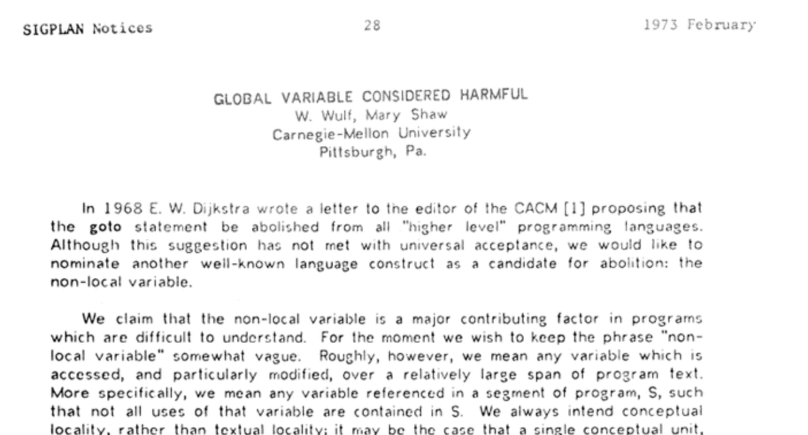
Breaking the rules
Rebecca Scott | me@rebeccascott.name | becdetat.com
Notes:
Now, global variables have famously been "considered harmful" since 1973.
I've known this my entire career.
But my “considered harmful” code actually let me avoid breaking several SOLID principles.
Knowing the basic rules and principles,
and doing a cost-benefit analysis,
Let me find a middle ground, a trade-off, that was ”good enough”.
A kind of “harm reduction”.

Slide 69
Breaking the rules
The Rule of Three: Three strikes and you refactor
Rebecca Scott | me@rebeccascott.name | becdetat.com
Notes:
Embrace the rule of three.
Write something similar two times, and on the third time refactor it.
It's surprising how often the second or third time is unique enough
that you never actually end up de-duplicating and refactoring.
And remember, you can use this principle outside of software development

Slide 70
Breaking the rules
“If you finesse, you end in a mess.”
- David French
Rebecca Scott | me@rebeccascott.name | becdetat.com
Notes:
Many many yeats ago my financial planner boss, taught me this:
"If you finesse, you end in a mess".
This stuck with me, and I use it constantly.
We want to write beautiful, elegant, and highly finessed code,
that works perfectly for the cases that we optimize it for,
but as soon as we try to apply it to a new case that doesn’t quite fit,
that elegance falls away.
We rarely have the luxury of rewriting everything whenever we touch it
Often, going with a simple solution up-front is a better long-term decision.
And, remember that David wasn’t talking about software development.

Slide 71
Breaking the rules
Know the rules, and when to break them.
Embrace the Rule of Three
“If you finesse, you end in a mess”
Rebecca Scott | me@rebeccascott.name | becdetat.com
Notes:
So, know the rules, the best practices, industry standards,
And know when to break them.
Embrace the Rule of Three,
And avoid early optimization and finessing.
DRINK

Slide 72
Sunk cost fallacy
Ambiguity effect
Cost-Benefit analysis
Asking good questions
Applying the LRM principle
Breaking the rules
Deferring learning
Hustle vs Sustainability
Rebecca Scott | me@rebeccascott.name | becdetat.com
Notes:
It's practically impossible just to be aware of every new development in our industry.
Since we can’t know everything, we just can’t make every decision 100% effectively.
We’re not going to make the right decisions all the time.
The trick is that we don’t need to.
So, invest your time carefully.

Slide 73
Deferring learning
“A monad is a monoid in the category of endofunctors, what’s the problem?”
- James Iry
Rebecca Scott | me@rebeccascott.name | becdetat.com
Notes:
Learn about functional programming because it's interesting.
Not because you're feeling FOMO and like you're a lesser person for using a `for` loop.
Learn on the job when you can.
If you've got it, use paid professional development time as much as possible.

Slide 74
Deferring learning
“A monad is a monoid in the category of endofunctors, what’s the problem?”
- James Iry
Rebecca Scott | me@rebeccascott.name | becdetat.com
Notes:
Look for employers that provide paid professional development,
Because they value their employees and are investing in them.
If you take opportunities for professional development seriously,
you're investing in yourself and in your career,
in a way that lets you continue to live your life.
FLIP & DRINK

Slide 75
Deferring learning
“It’s three AM and I feel like I've barely scratched the surface of hardware description languages. I've got to start work in six hours to write this web application, and I still don’t really understand what a React hook does. I forgot to take the garbage out. I need a shower.”
Rebecca Scott | me@rebeccascott.name | becdetat.com
Notes:
Deciding to learn something is an investment, so treat it like any other investment.
Cost vs benefit, learn about opportunity cost.
And apply the last responsible moment principle to your learning practice.
And remember the sunk cost fallacy.
Quitting a bad choice is a good thing.

Slide 76
Deferring learning
Our industry moves faster than we could ever hope to.
Learn for fun and for work, not because of FOMO.
Take professional development opportunities seriously.
Apply LRM and cost vs benefit to learning.
Rebecca Scott | me@rebeccascott.name | becdetat.com
Notes:
So,
Learn for your work, and for your own enjoyment,
not because of your fears or anxieties.
If your employer offers professional development time,
take advantage of it,
take that time seriously.
And, apply your best decision making skills to how you approach learning.
DRINK

Slide 77
Sunk cost fallacy
Ambiguity effect
Cost-Benefit analysis
Asking good questions
Applying the LRM principle
Breaking the rules
Deferring learning
Hustle vs Sustainability
Rebecca Scott | me@rebeccascott.name | becdetat.com
Notes:
Maybe it sounds like I’m telling you to be lazy and selfish.
Well, there's a lot of hustle in this job.
We learn in our own time,
we often work long hours.
So maybe some selfishness is appropriate.

Slide 78
Hustle vs Sustainability
The myth of multitasking
Rebecca Scott | me@rebeccascott.name | becdetat.com
Notes:
Multitasking:
Context switching cost
More mistakes
More stress
Being in a “boring” meeting and multitasking

Slide 79
Hustle vs Sustainability
Burn-out
Rebecca Scott | me@rebeccascott.name | becdetat.com
Notes:
Burn-out is a big problem in this profession.
I've burned out numerous times,
usually with serious personal consequences.
I've needed to take extended leave,
seek medical help,
and I’ve even had to leave a couple of jobs

Slide 80
Hustle vs Sustainability
Burn-out
Rebecca Scott | me@rebeccascott.name | becdetat.com
Notes:
The job itself was only responsible for maybe 20% of that burn out.
I put too much pressure on myself,
and my relationships, my mental health,
and my psychological safety suffered as a result.

Slide 81
Hustle vs Sustainability
Burn-out
Rebecca Scott | me@rebeccascott.name | becdetat.com
Notes:
I still struggle, every day.
If you're coming to a conference like this,
you’re investing in your career
and probably intending to be in this profession for a long time.
So while you're learning to make good decisions for your project or your client,
try to make sure they're also good personal decisions.
DRINK

Slide 82
Summary
Time is finite, spend it carefully.
Cognitive biases affect our decision making processes.
Use LRM and Cost-Benefit analysis to make effective decisions.
Get good information by asking good questions.
Know the rules, so you know when to break them.
Make good decisions when learning and during professional development.
Small decisions make up long-term sustainability.
So, make good decisions for yourself.
Rebecca Scott | me@rebeccascott.name | becdetat.com
Notes:
Almost done!
Our time here is finite, so we should spend it, invest it, carefully.
Cognitive biases affect our decision making processes,
So it’s important to understand them and their effects.
Applying the Last Responsible Moment principle
and using cost-benefit analysis
can help with making effective decisions.
We can only make good decisions if we have good information,
and by asking the right questions at the right time.

Slide 83
Summary
Time is finite, spend it carefully.
Cognitive biases affect our decision making processes.
Use LRM and Cost-Benefit analysis to make effective decisions.
Get good information by asking good questions.
Know the rules, so you know when to break them.
Make good decisions when learning and during professional development.
Small decisions make up long-term sustainability.
So, make good decisions for yourself.
Rebecca Scott | me@rebeccascott.name | becdetat.com
Notes:
Know the rules and principles that influence our industry,
so that you know how to apply them and when to break them and why.
Professional development time is highly valuable.
Take advantage of it and make good decisions around your PD.
And, long term, your time in this industry is made up of lots of small decisions.
So, make sure you’re making good decisions for yourself.

Slide 84
Minimum viable programmer
Rebecca Scott | me@rebeccascott.name | becdetat.com
Notes:
Thank you!
DRINK!!!

